Slide 1
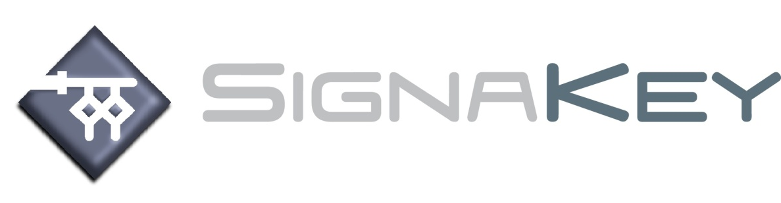
SignaKey Tamper Prooof Engine Seals
Jamie Knight
jkni@signakey.com
+44 (0) 20 3575 1378 - Office
+44 (0) 7967 077536 - Cell

Slide 2
SignaKey and E-labelling
SignaKey through a partnership with ECC Corporation recently had a global specification for e-Labelling published by IECQ following an audit and approval by BSI. This specification: IECQ-CS 033000-UK 0001 can be found on the IECQ website.”

Slide 3
SignaKey and Tamper Proof Seals
Our Tamper Proof Seals enable full control and security for critical systems.
The track and trace capability ensures a fully traceable record of all transactions and interactions.
Adding value and assurance across a multitude of industries and applications

Slide 4
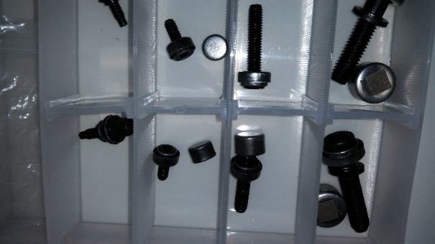
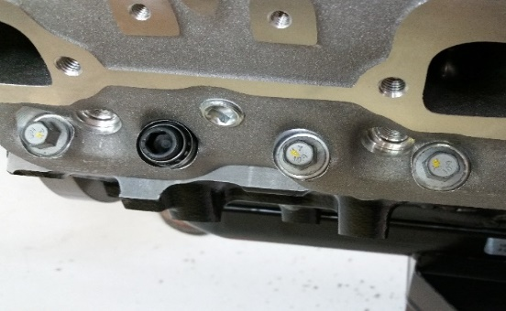
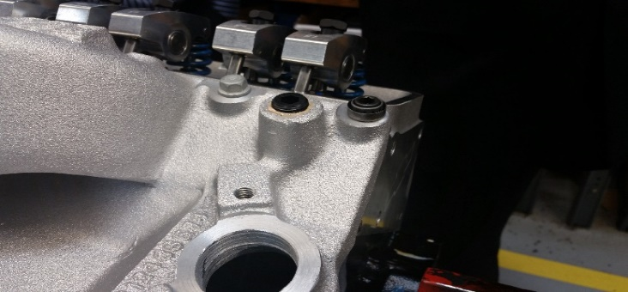
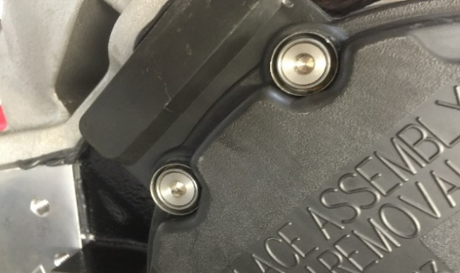
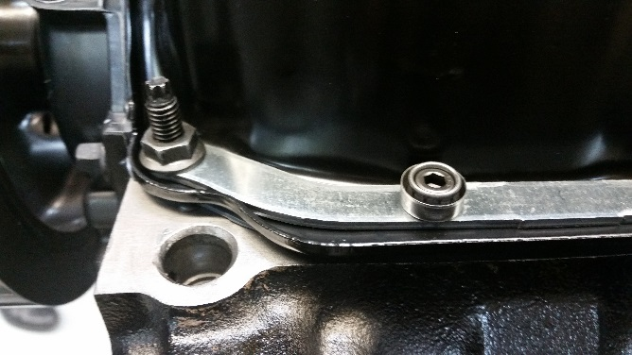
CT400 – Production intent Signakey Bolt trial
Signakey (Richard McDermott) brought a complete set of pre-production sealing bolts to PAS for a trial fit up on a CT400 crate engine.
It was agreed that the best method for supplying the sealing bolts to PAS for installation on the engine would be in individual kits (Fig. #1) ensuring that the bolts, caps, bases and washers would remain intact (no small parts would be lost).
PAS will install the cap head bolts with the Signakey bases onto the engine during initial assembly. The caps will be installed onto the engine once the engine passes “cold test”.
Overall the trial installation went very well with no issues (Figs #2-#5).
Bolt Tray – Fig. #1
Head Bolt – Fig. #2
Intake Manifold Bolt – Fig. #3
Front Cover Bolt – Fig. #4
Oil Pan Bolt – Fig. #5

Slide 5
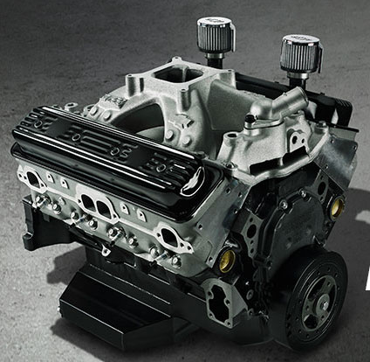
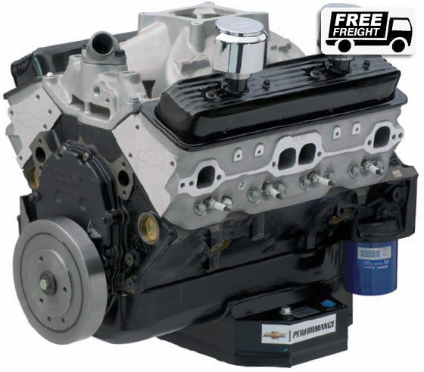
Proposed Location Nomenclature
IMR
IMF
CHR
OPR
FCR
FCL
OPL
CHL

Slide 6

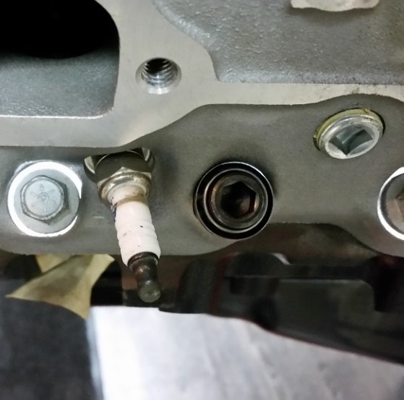
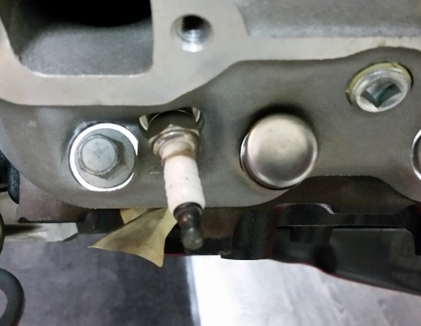
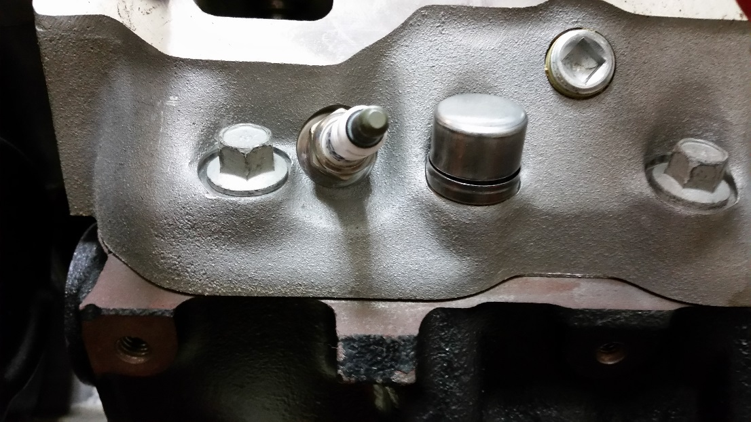
Signakey Sealing Bolt – Cylinder Head
The prototype sealing bolt for the CT400 cylinder head was mocked up at PAS on 2/10/16.
No issues were found (see pictures below)
Clamp load validation will need to be conducted once part with the height shim are available.

Slide 7
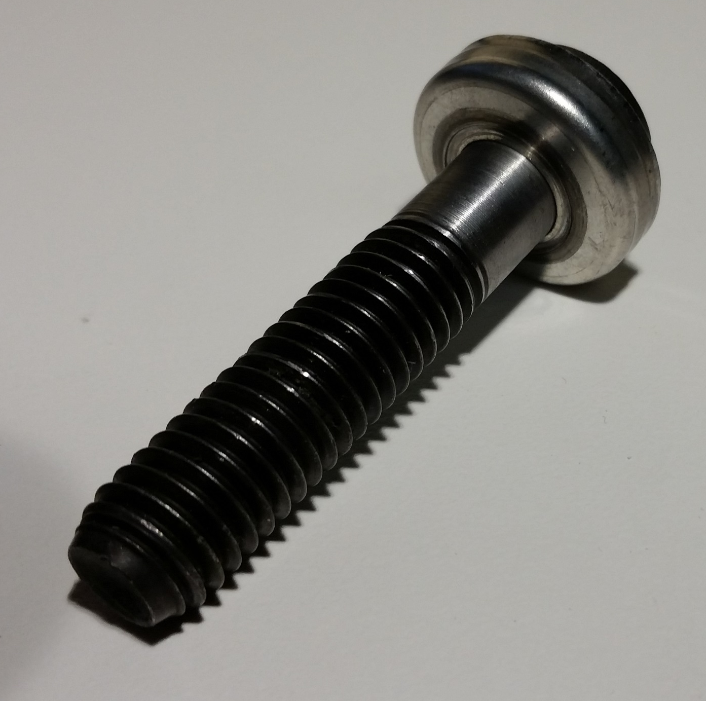
Signakey Head Bolt without hardened head bolt washer

Slide 8
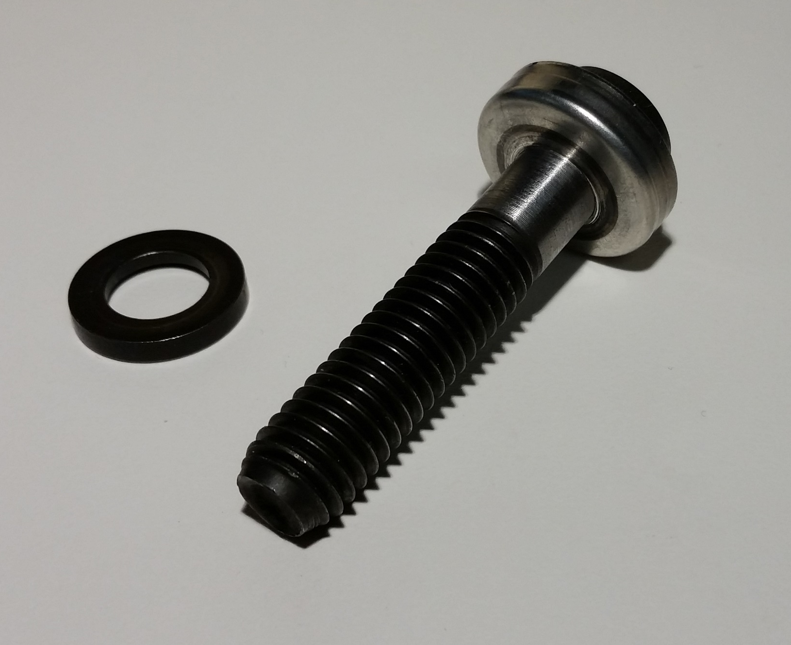
Signakey Head Bolt with hardened head bolt washer

Slide 9
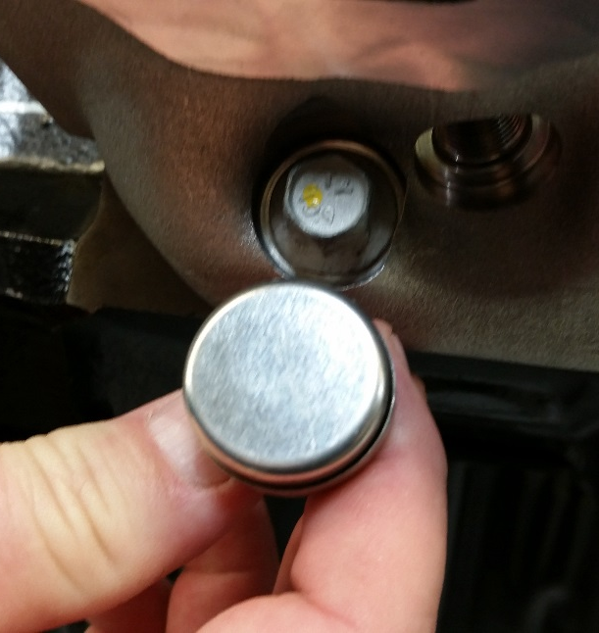
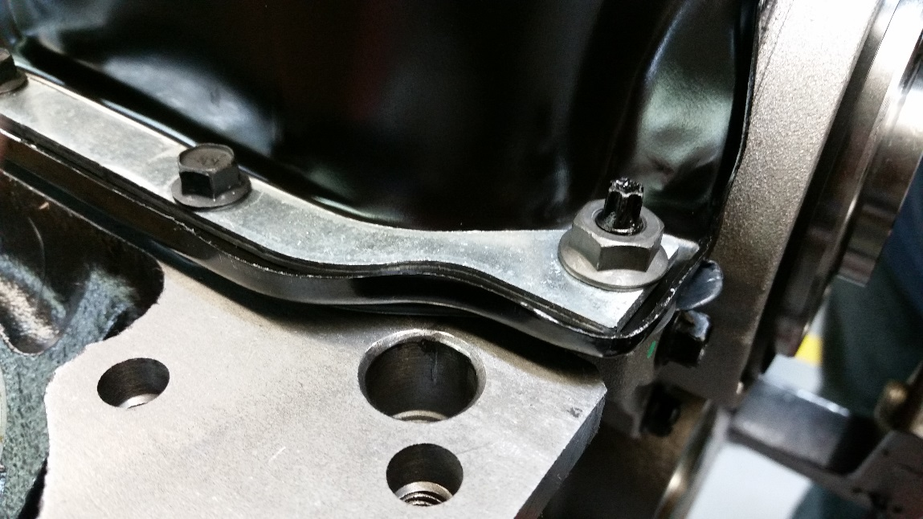
SignaKey Sealing Bolts
Steel insert
Head Bolt spot face
Oil Pan Flange
Head Bolt – spot face on the cylinder head is not large enough to accommodate the ‘Cup’ seal
Oil Pan Bolt – while the picture does not clearly show it, the flange of the oil pan is higher than the surface of the steel insert which will limit the radial clearance for the ‘Cup’ seal

Slide 10
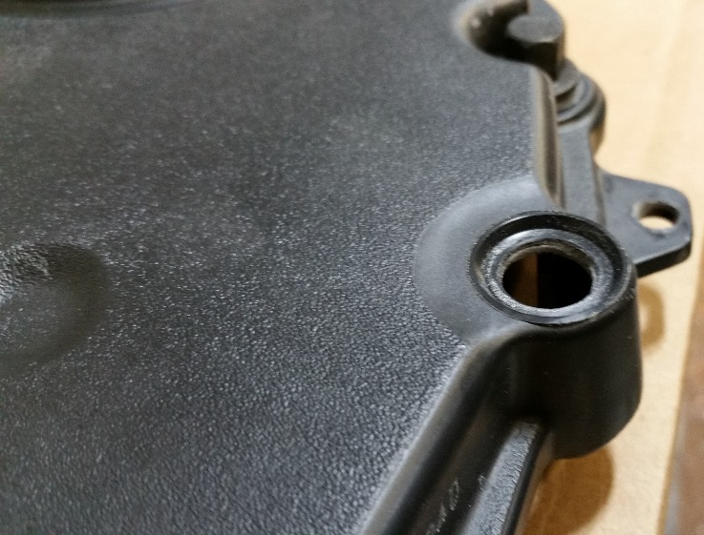
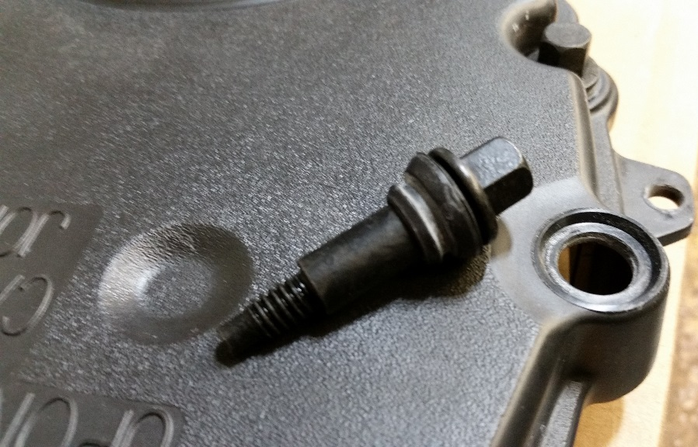
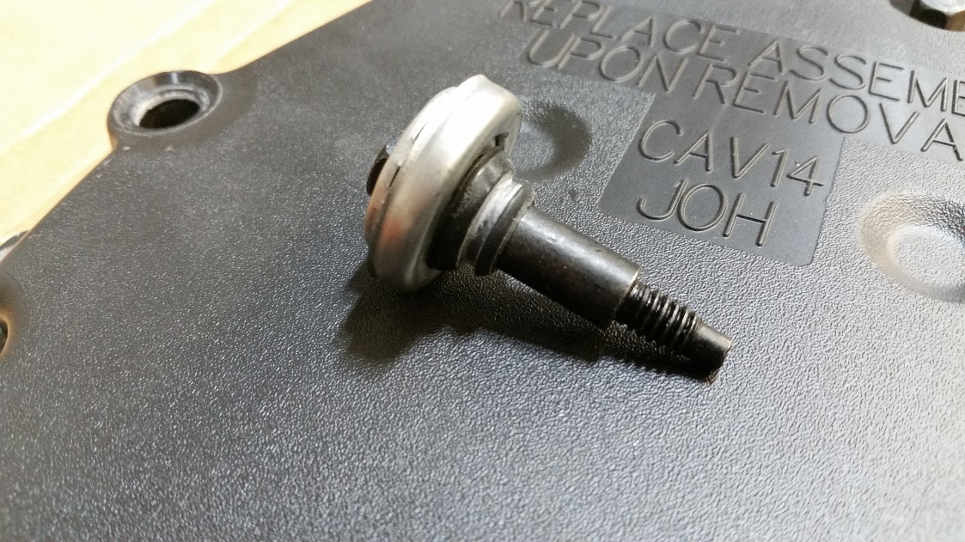
SignaKey Sealing Bolts
Counterbored hole
Rubber sealing washer with integral torque limiter
Bolt Flange
Front Cover Bolt – the front (timing chain) cover is attached with special fasteners that incorporate a rubber sealing washer with a plastic feature that limits the amount of torque that can be applied to the bolt. It appears that installing the base of the ‘Cup‘ Seal between the rubber sealing washer and the flange on the bolt would ensure that the front cover doesn’t leak around the bolt and that the base of the ‘Cup’ Seal is above the counterbore in the cover.
‘Cup’ seal (base) to be installed between the rubber sealing washer and the flange on the bolt.

Slide 11

What is a SignaKey?
It looks like this
Uses NSA Suite B, FIPS Compliant, AES 256 Bit, Secure Hash Algorithm Encryption
256 Hexadecimal data symbols enables 5.19 X 10³³ unique identifiers
Fast decode (< 3 seconds) with $7.95 webcam or Smartphone
VERY SECURE
A LOT!!!!
FAST AND LOW COST.

Slide 12
SignaKey Mark Consists of “Y”
Y
Binary equivalent = 0
If only these 2
Y
Binary equivalent = 1
Y
Quatnary equivalent = 0
Y
Quatnary equivalent = 1
If there are 4
Y
Quatnary equivalent = 2
Y
Quatnary equivalent = 3

Slide 13
How Does a SignaKey work?
Virtually Unlimited Quantities
All 256 Data Symbols Shown
256 Data Hexadecimal Data Symbols provides
5.19 Decillion Unambiguously Unique Marks
5,190,000,000,000,000,000,000,000,000,000,000
Orientation
Symbols

Slide 14
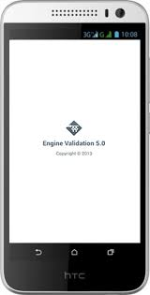
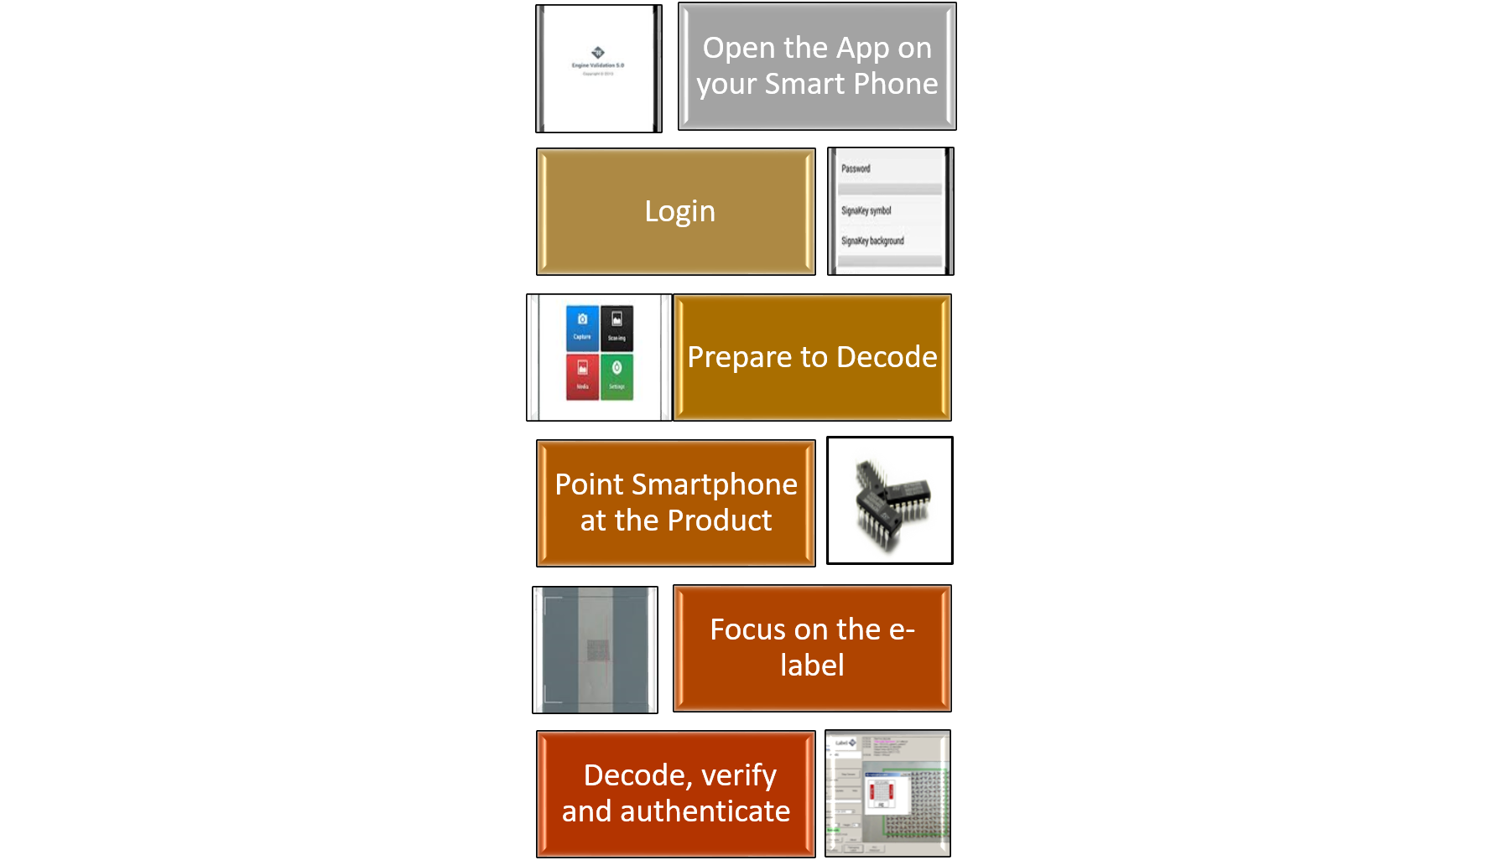
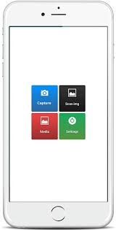

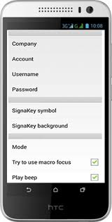
How is it decoded ?

Slide 15
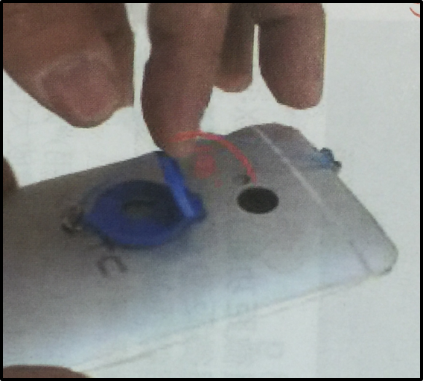
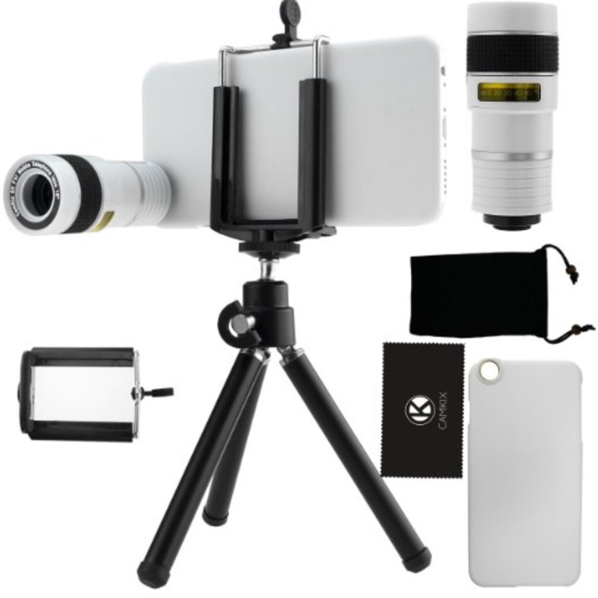
How is it decoded ?

Slide 16
Smart App Examples ?

Slide 17
What can you use SignaKey for ?
Security / Brand Protection
Electronic components
  Counterfeit prevention / authentication
  Serialisation
Documentation
Supply Chain Movement
Pharmaceuticals
Medical
High Value Goods

Slide 18
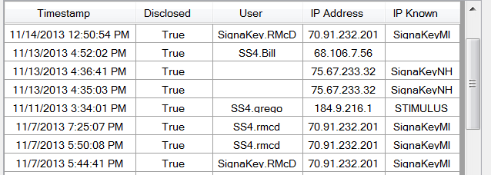
Post Authentication History
②
①
The component was decoded after testing by the user: SS4.RMCD at IP address 70.91.232.201 @Timestamp 11/7/2013 7:25:07PM. See record ①
The component was then sent via FedEx to Stimulus Engineering where it was decoded by user: SS.grego @ IP address 184.9.216.1 @ Timestamp 11/11/2013 3:34:01 PM. See record ②

Slide 19
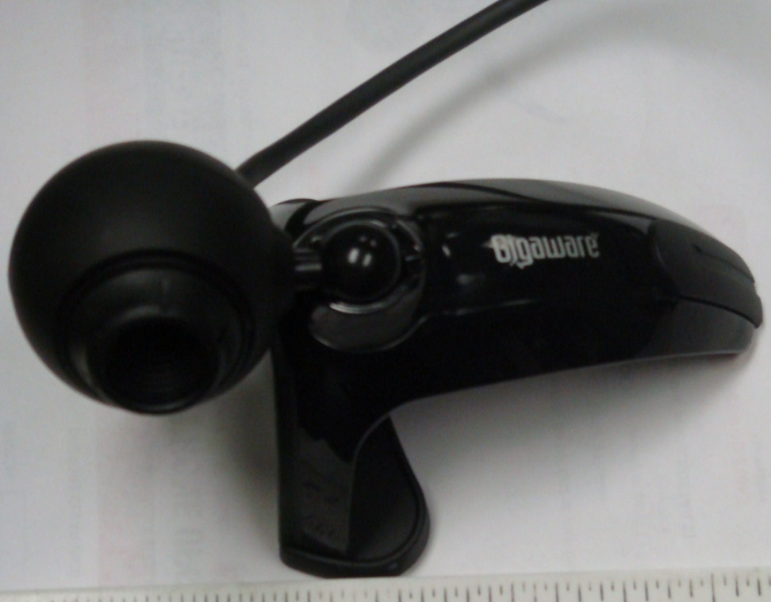
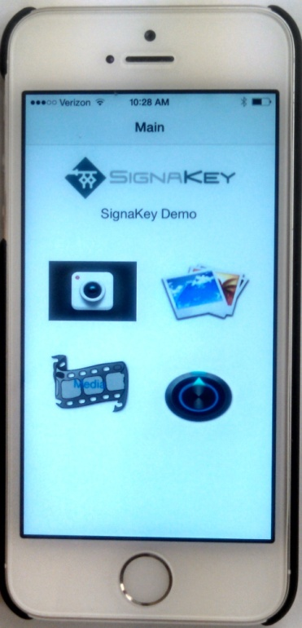
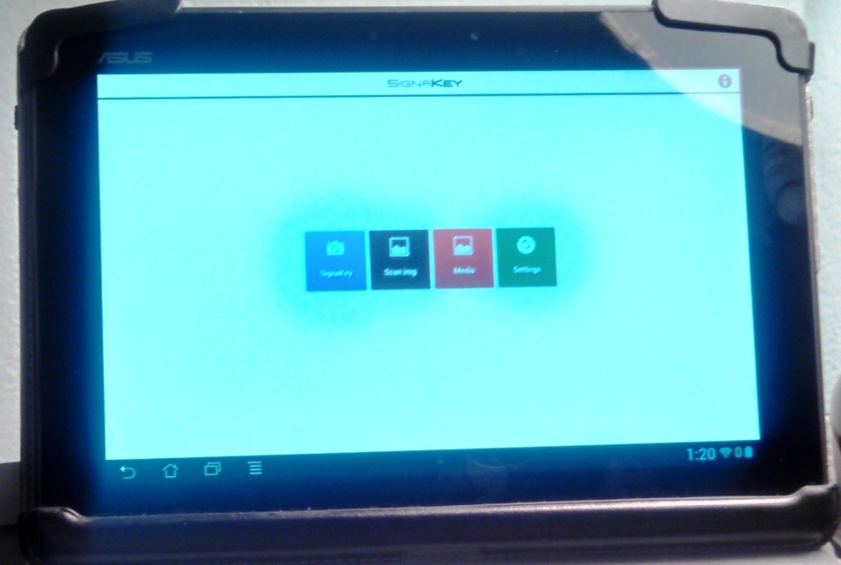
How is a SignaKey Decoded
$7.95 Webcam from Walmart
Apple I Phone or I Pad
Android Tablet or Smartphone

Slide 20
What do You Get With SignaKey ?
A uniquely identified part / component.
With bespoke attachments.
From a Secure data base.
Easy to decode and in real time.
Traceability down Supply Chain after inspection.
Secure Database can be hosted wherever required.

Slide 21
Summary
Supply Chain Track and Trace
Counterfeit Prevention
Product Authentication
Enhanced security
E-Labelling
Questions.

